Slide 1


CJS –Op Snap

Slide 2
Operation Snap - Intro
Operation (Op) Snap is the West Midlands Police version of the NPCC initiative, where members of the public can submit footage of dangerous or careless driving offences to their local police forces via a streamlined online portal (Nextbase).
Op Snap commenced in WMP in 2015 in Roads Policing and thereafter, moved to CJ in 2017. In 2017, the year submission rate was 208 submissions in comparison to 14,650 in July 2025.
The program aims to improve road safety by enabling the police to investigate footage directly combatting those driving dangerously and demonstrating how we are engaging communities to fight crime alongside us, as we work towards Vision Zero.
We proactively publish on a quarterly basis Op Snap metrics, to ensure we are working towards a common goal of information sharing to deliver a safe road network for the West Midlands Police Region whilst simultaneously, enhancing confidence, trust and legitimacy in policing.
There has been substantial media interest in the form of local campaign groups, Better Streets Birmingham and the West Midlands Road Safety Commissioner.
Category Filters (Fatal Four & Severity)
1. Dangerous / Careless / Inconsiderate Driving (including a Close Pass)
2. Using a Mobile Phone whilst driving
3. Not wearing Seat Belt
4. Not complying with a Red Traffic Light
5. School Parking
6. Parking (Residential Street / Pavement / Obstruction/ Zigzags)
7. All other offences not listed above

Slide 3
Demonstration of OP Snap
External
National Dash Cam Safety Portal | Nextbase
Internal https://nextbase.egresscloud.com/w/edit/5a155a65a0fe2c56f7e459a9/

Slide 4
OP Snap - Performance
AODS | Total Number | Positive Outcome Rate | NFA | Other (RTC/False Plates)
January 2025 | 1,662 | 87% | 11% | 2%
February 2025 | 2,098 | 86% | 12% | 2%
March 2025 | 2,441 | 86% | 13% | 1%
April 2025 | 2,029 | 25% | 74% | 1%
May 2025 | 2,158 | 66% | 33% | 1%
June 2025 | 2,184 | 55% | 43% | 2%
July 2025 | 2,078 | 64% | 35% | 1%
August 2025
September 2025
October 2025
November 2025
December 2025
Year | Number of reports received
2017 | 208
2018 | 1158
2019 | 3242
2020 | 3,549
2021 | 3,761
2022 | 5,551
2023 | 7,145
2024 | 16,267
2025 | 14,650

Slide 5
OP Snap- Performance

Slide 6
OP Snap - Performance – NFA Rational

Slide 7
OP Snap - Performance – Other Disposals

Slide 8
OP Snap - Conclusion – Future Considerations
Future Considerations
Can the force meet the demands or has it generated such demand that it has become a challenge? - Category Filter /Severity Assessment, Positive Action on all matters that are not NFA’d. Road Safety Proposal Uplift PC’s.
Is the system accessible to all or has it created a 2 tier system of policing whereby members of the public with a vehicle or dash cam receive an enhanced level of service compared to those who cannot afford these assets? - Dash Camera , Mobile Phone and Local Authority CCTV
Op Snap is a proactive tool that assists in ensuring our roads are safe, whilst recognising the positive contribution our local community can play in directly influencing attitudes. Op Snap has ensured that crime (street racing/dangerous driving) and anti-social behaviour is prevented and tackled, that we promote road harm reduction and that we reduce the number of people, tragically and avoidably killed and seriously injured on our roads.

Slide 9
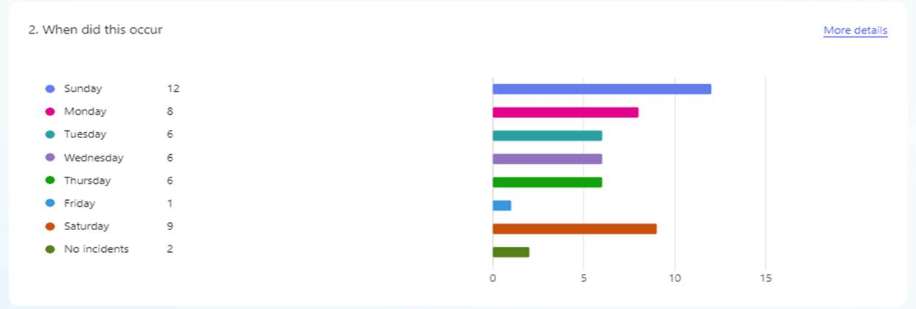
Op Snap- Dudley LPA- tackling street racing/dangerous driving/ due, care & attention and anti-social behaviour
Pre Use of Op Snap- 29/04/24 to 23 /12/24 on average 48 incidents per week.

Slide 10
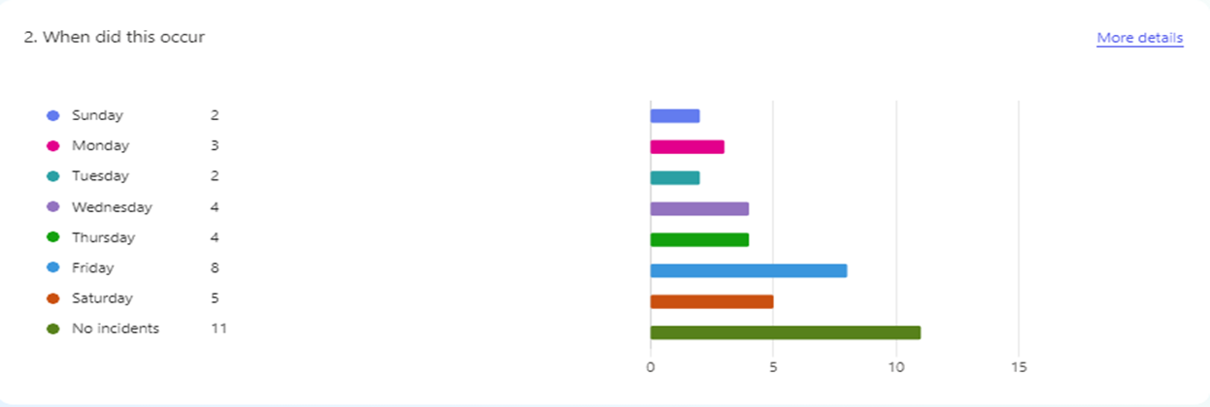
Dudley LPA- tackling street racing/dangerous driving/ due, care & attention and anti-social behaviour
Use of Op Snap- 30/12/24 to 26/05/25 on average 28 per week.

Slide 11
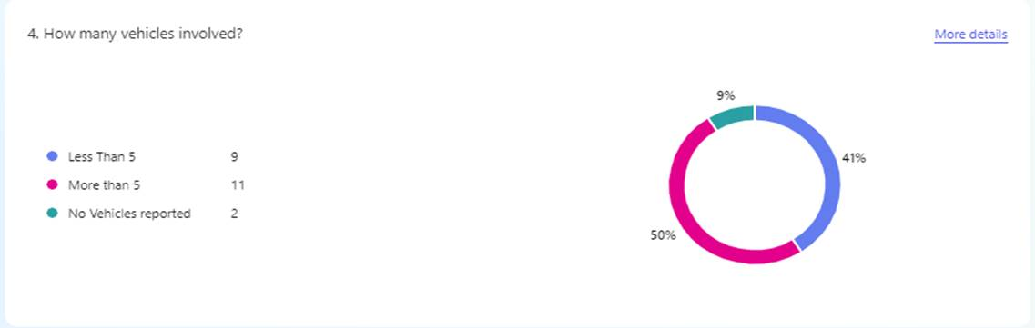
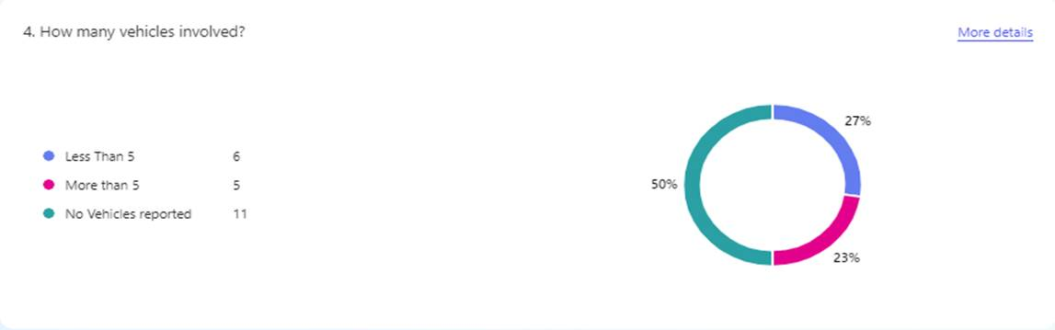
Dudley LPA- tackling street racing/dangerous driving/ due, care & attention and anti-social behaviour
Pre Use of Op Snap- 29/04/24 to 23 /12/24
Use of Op Snap- 30/12/24 to 26/05/25
WaterFront Security Dudley Car Park - “It also makes our lives easier, and I would assume saves police resources, because we aren't phoning 101 to report these they're just going straight through to your end and being dealt with. There has been a few occasions where we have rang 101 to report some anti social behaviour in vehicles and the police have not made it in time so to catch them after the fact is better. ”

Slide 12
OP Snap - Conclusion –
Proactive Citizen vs Passing Citizen
1st January 2025- Present
Person A = 753 submissions , Predominant offence; Parking
Person B = 274 submissions, Predominant offence; Mixture of offences reported
Person C = 271 submissions, Predominant offence; Red Light / Mobile Phone / Close Pass
Person D = 228 submissions, Predominant offence; Mobile Phone / No Right Turn / Close Pass
Person E = 198 submissions, Predominant offence; Red Light
Person F = 188 submissions, Predominant offence; Dangerous Position outside School (school caretaker)
Person G = 176 submissions, Predominant offence; Mobile Phone
Person H = 137 submissions, Predominant offence; Parking
Person I = 105 submissions, Predominant offence; Close Pass
Person J = 94 submissions, Predominant offence; Mixture of offences reported
Person K = 66 submissions, Predominant offence; No Right Turn
Person L = 56 submissions, Predominant offence; Close Pass

Slide 13
Working in partnership, making communities safer west-midlands.police.uk

