Slide 1


Slide 2

Introduction
This session provides an update on:
  National Portfolio Update
  West Midlands Update

Slide 3
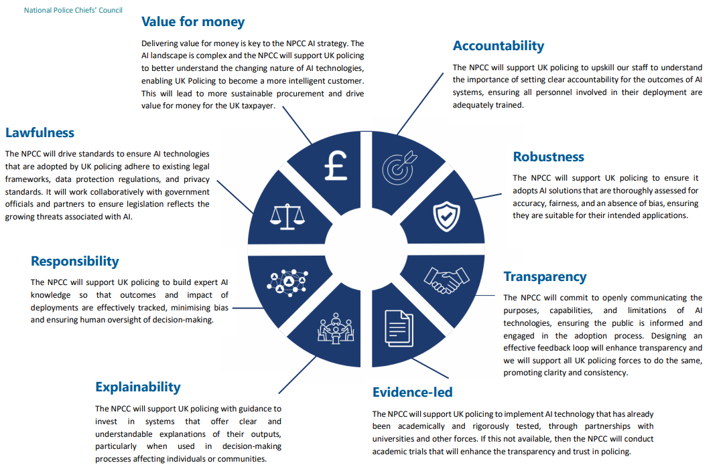
Vision statement
Our ambition is to establish UK policing as a leader in applied responsible AI. Deploying well designed, rigorously tested and evidence-based AI will make UK policing more effective at preventing, detecting and investigating crime, improve public engagement, and increase police productivity. It will also improve our ability to respond to the criminal misuse of AI.
NPCC AI Strategy Overview
Enhanced Productivity
Use of LLMs, RPA, NLP, and computer vision
Focus on efficiency and value for money
2. Tackling Crime and Harm
AI for prevention, detection, and investigation
Tools: machine learning, facial recognition, NLP, risk modelling
3. Countering Criminal Threats
Detect and respond to deepfakes, fraud, misinformation
Support legislative updates
Monitor emerging threats

Slide 4
Current Position Nationally
  Cross public sector exploration of AI, from the Home Office to the Information commissioners' office
  All forces at various stages of experimentation and development
  Three methods of AI development
    AI’s being built by forces such as Andi-Esra and LLM’s in Azure
    Third party supplied, i.e. GoodSam, Evidence.com etc.
    Co-Pilot
  Copilot chat achieved national assurance July 17th
  Copilot 365 national assurance targeted for 18th September
  SOCEX environment pushed out nationally

Slide 5
NPCC AI Productivity Working group
  First meeting 19th September
  Focus is to coordinate AI national adoption through:-
      Identify - AI with potential for significant productivity benefits for policing.
      Assessment - Independent via the College of Policing
      Technical assurance – Via PDS to include DPIA and Blueprinting
      Showcasing – NSIB
  Joint Operational Procedures between Police and CPS
  First batch of tools being considered include:-
    Decision support tools such as COPPA
    Drafting tools such as MG11 in Goodsam
    Object recognition such as BriefCAM
    Copilot as generic business tool
    Data Exploitation such as SOZE
    Transcription/Translation considerations about national accreditation

Slide 6
West Midlands Police
  Agreed governance – Change Board
  Mapping all tools in use
  A cautious approach
    Watching what gets nationally assured
    Limited targeted self creation LLM
    Focus on improving Andi_Esra and Calabrio
  Will consider CoPilot Chat in October and a caution exploration of Copilot 365

