Slide 1


BIRMINGHAM EAST (BE)
STOP & SEARCH
Tuesday 28th July 2015
Notes:
This is the first screen. Please add your presentation title. (You can delete this note when you’re done).

Slide 2
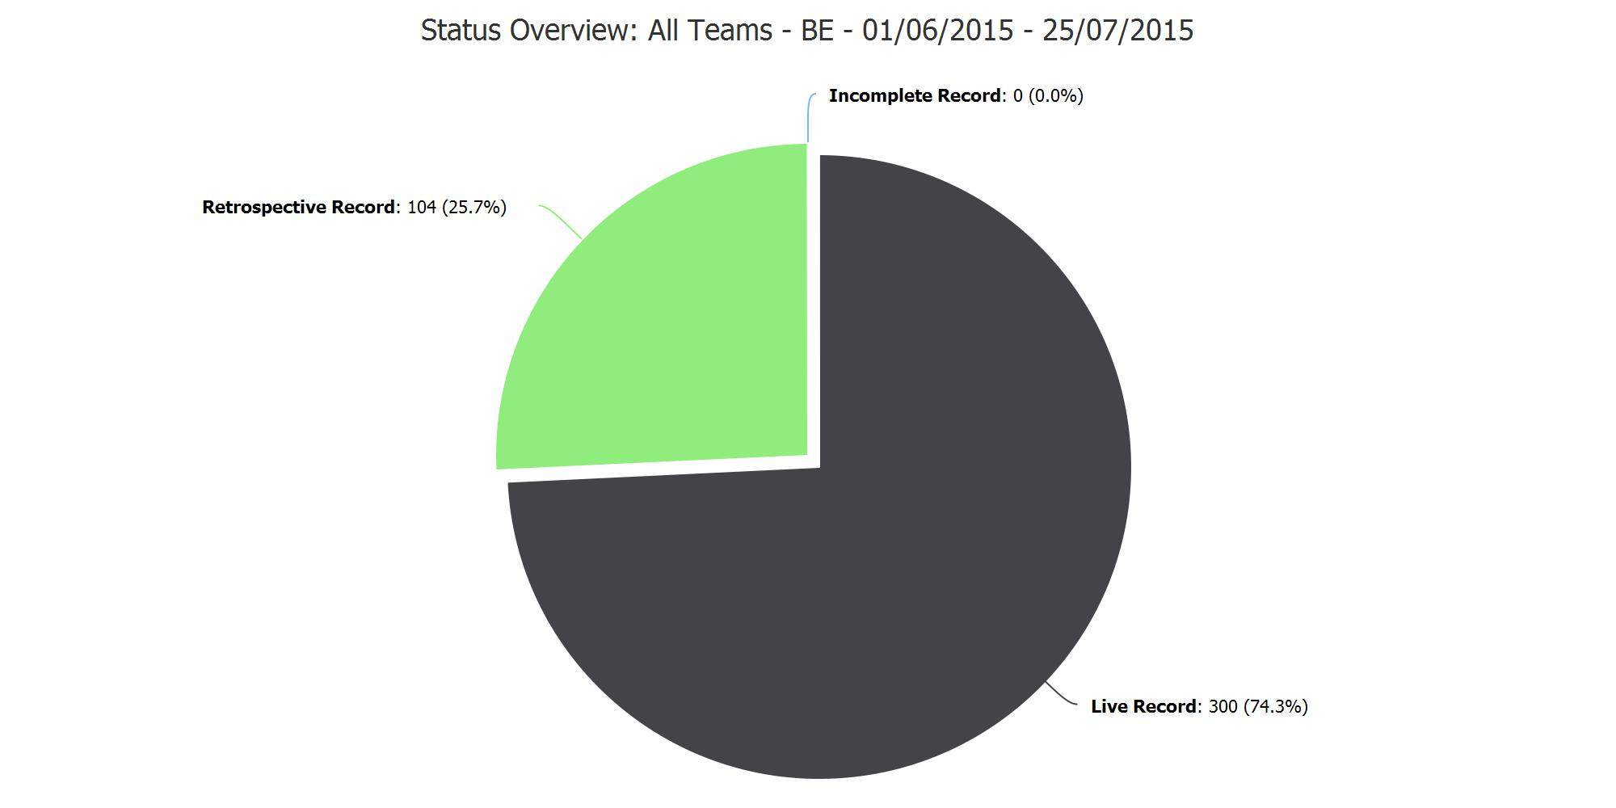
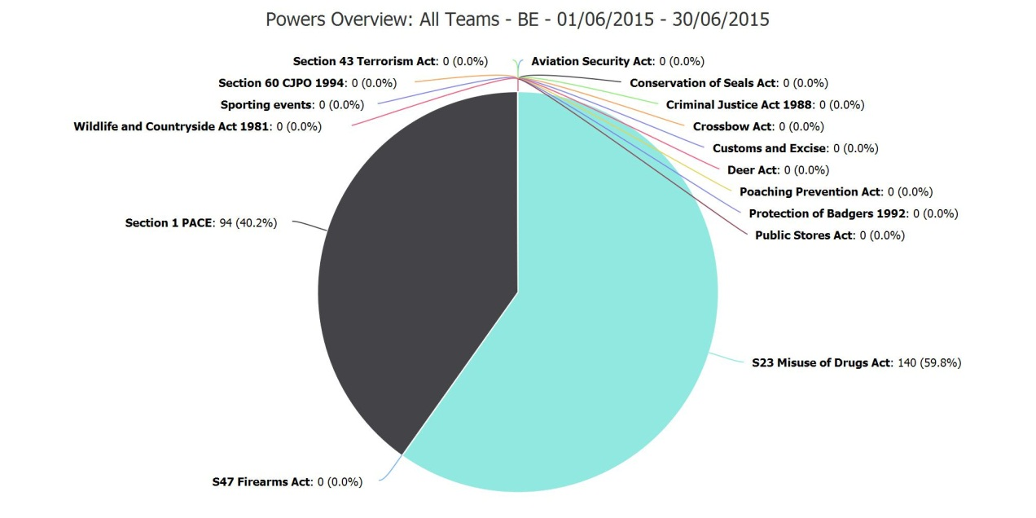

Slide 3
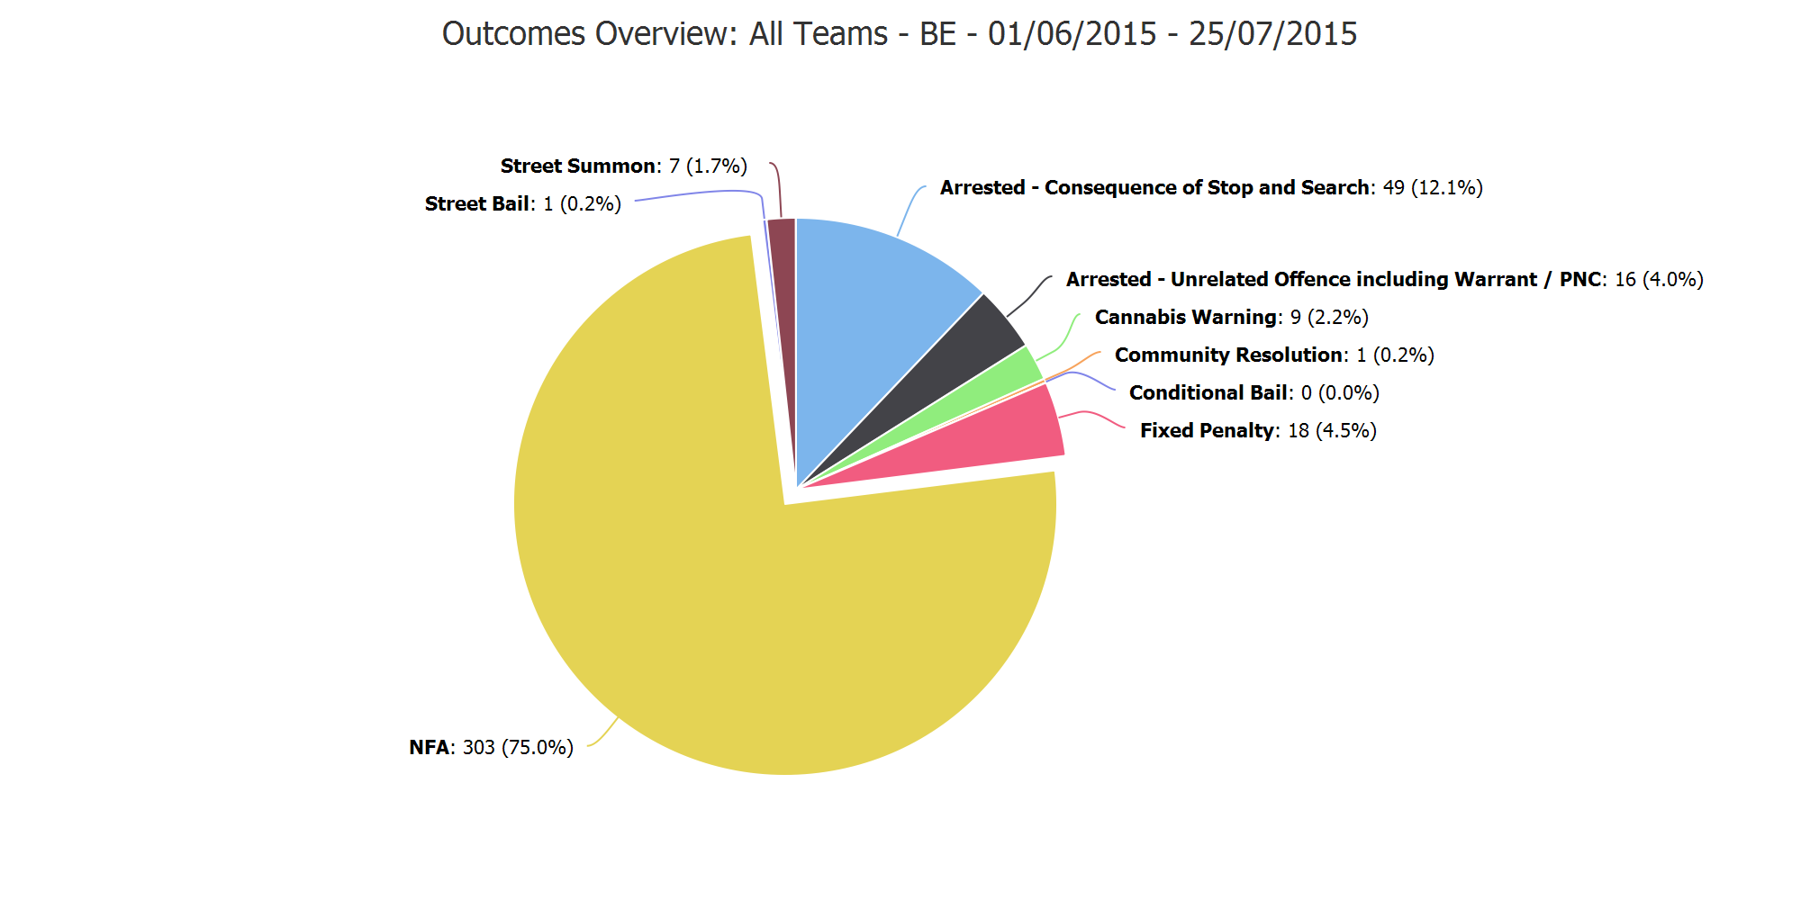

Slide 4
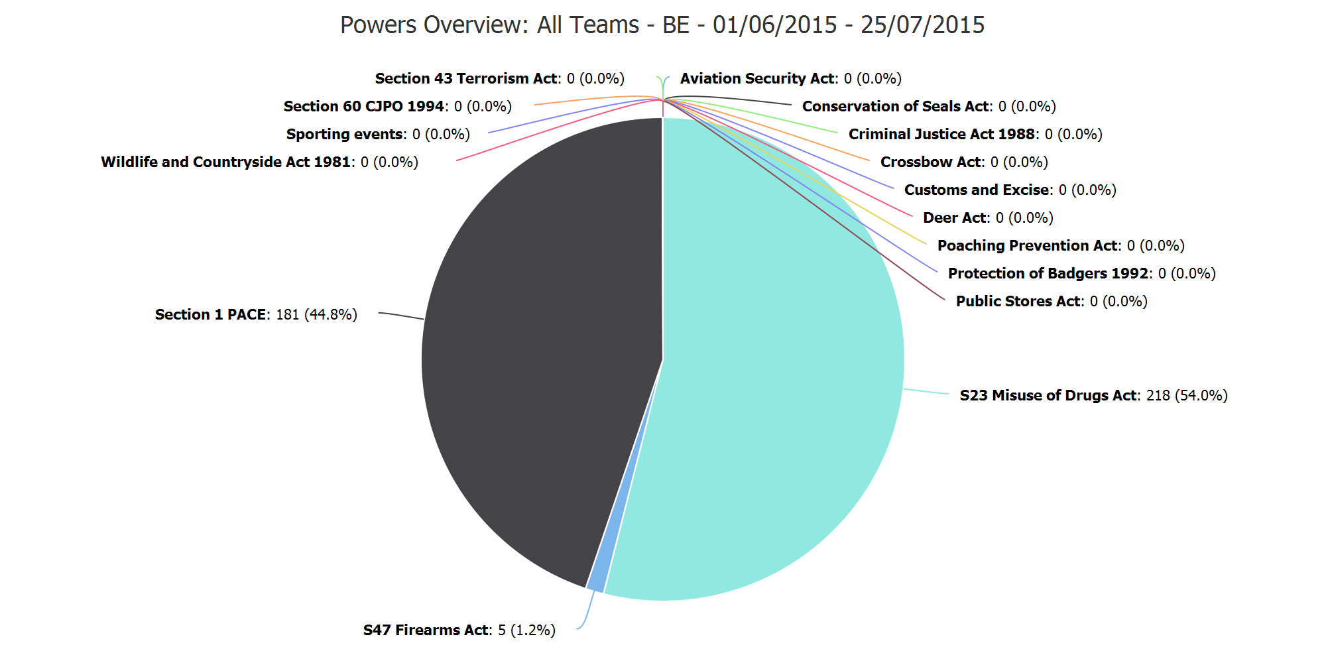

Slide 5
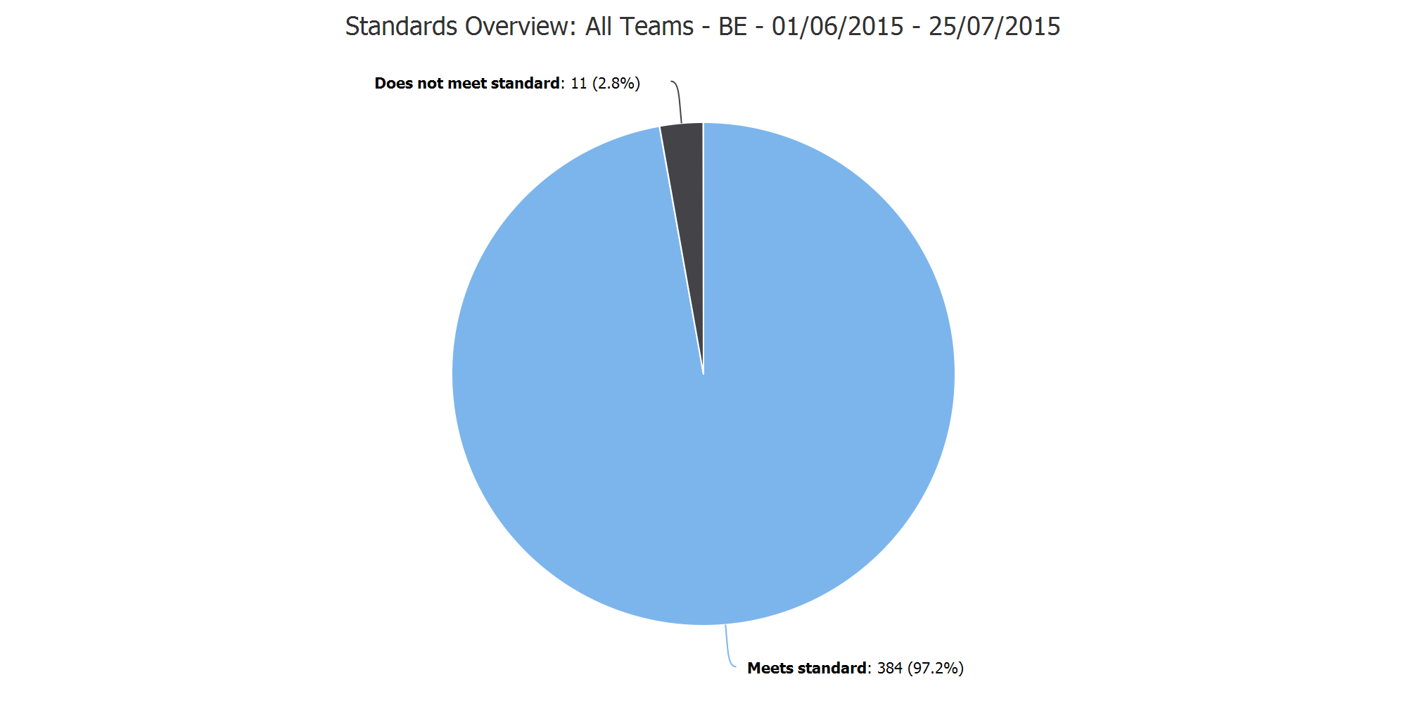

Slide 6
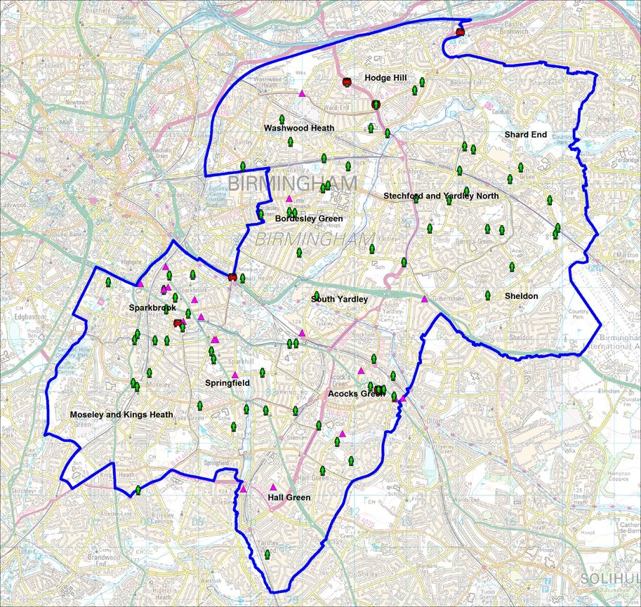

Slide 7
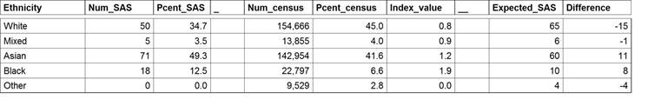
June 2015
This figure should be as close to the value 1
The number of people you’d expect to Stop & Search from each ethic background
The number of people that have been subject to a Stop & Search from each ethic background

Slide 8
